Slide 1




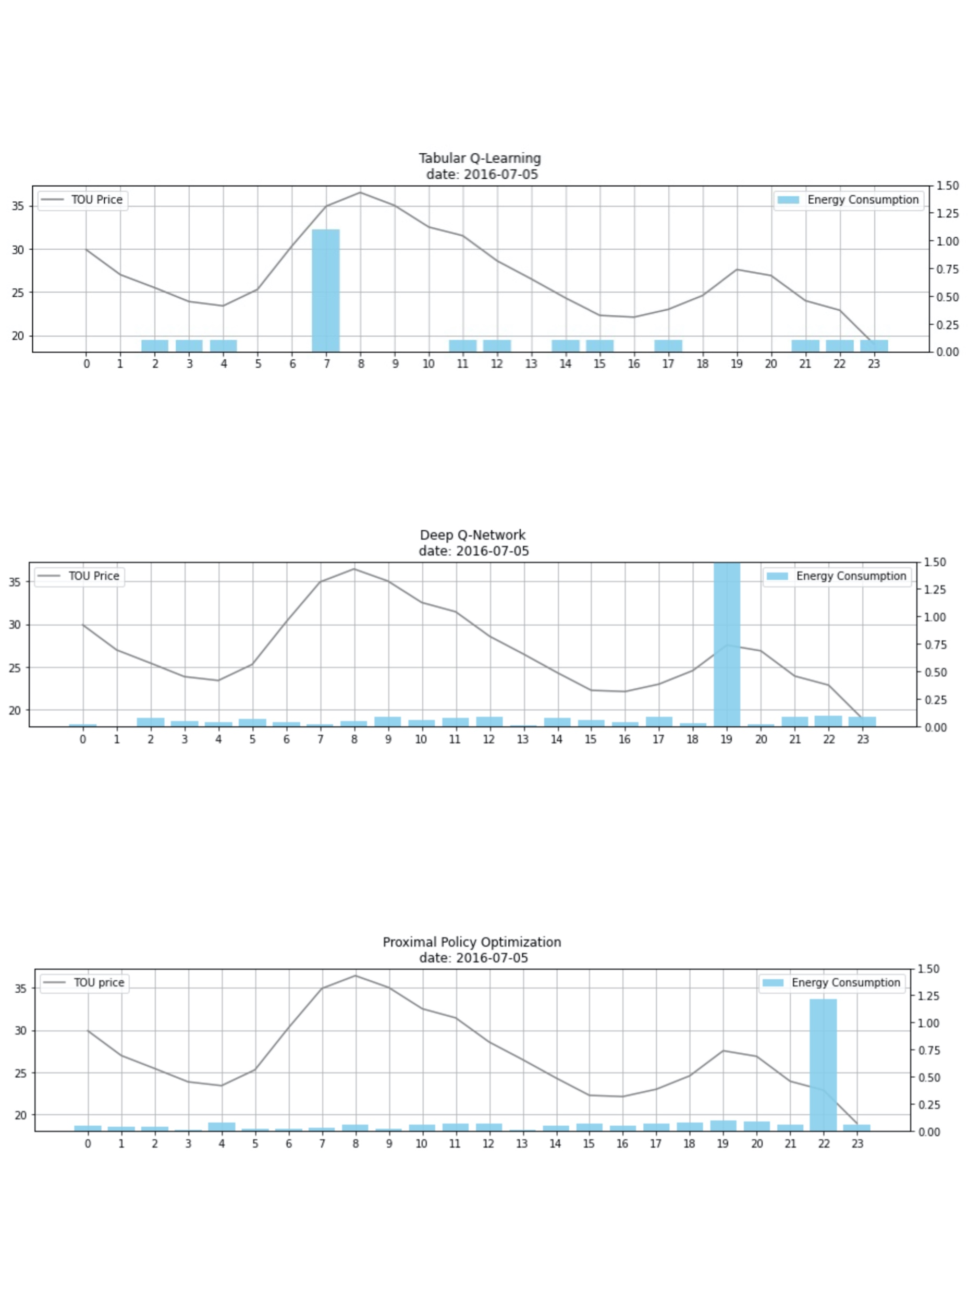
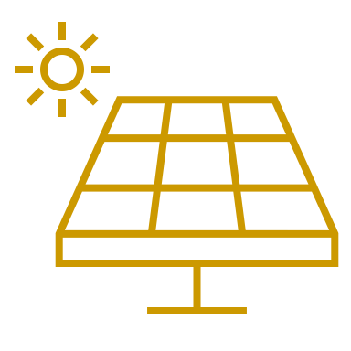






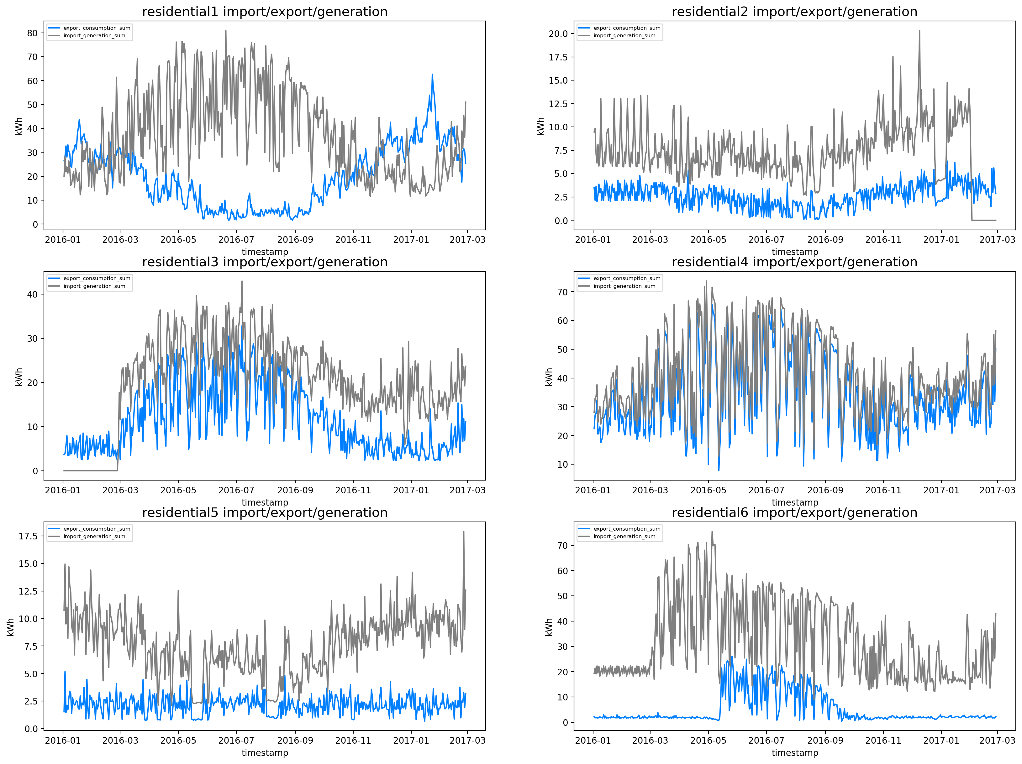
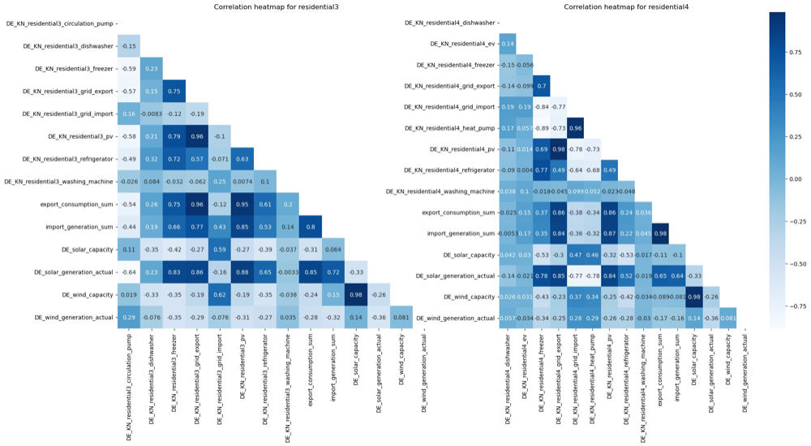
Reinforcement Learning Enabled Energy Optimization for Prosumers
Yunzhe Zhang, Yujia Xie, Hongtao Jiang, Zhining Qiu, Weisheng Chen
Industry Mentors: Bhushan Jagyasi, Bolaka Mukherjee, Anandu Balachandran
Faculty Mentor: Adam S. Kelleher
Data Science Capstone Project
with Accenture
Overview
With net-zero targets and real-time market pricing policies, consumers are being increasingly encouraged to invest in smart automation of energy management systems. The project goal is to develop a reinforcement learning model agent for prosumers and consumers, to minimize the overall energy cost and increase the renewable energy utilization. The solution will help control the flexible load and optimize the charging and discharging schedule of energy storage.
Reinforcement Learning With Q-Learning
For the agent training, we use offline learning policy including three main algorithms: Tabular Q-learning, Deep Q-learning, and PPO2. We trained three different agents for each kind of appliance and let them to interact with the environment we created.
Below are the graphs which show the agents states at each different time intervals during a random day. We could check whether these agents behave in a reasonable situation under some constraints we set in the MDP Formulation process.
Utility
Weather Station
Environment Development
Energy Savings
Varying Price
Energy Imports
Weather Information
Generates real time States, Reward and Next State dependencies in response to action
Test the trained agent and estimate monetary benefits over time horizon T compared against baseline methods
Household (Prosumer)
Flexible Loads
Fixed Loads
Energy Exports
Energy Storage Info
Environment
States S(t)
Action A(t)
Reward R(t)
Data Analysis
Agent Training
Battery Charge/ Discharge, Energy Export controls
Gather, preprocess and analyze data from households, industry plants, energy price, and weather station
Model Free RL algorithms – Q Learning, PPO, SAC, DDPG
Agent
Figure 1. Project Overview
Figure 2. Reinforcement Learning
Exploratory Data Analysis
Household (Consumer) Data - 6 residential household data is available. Different households show distinctive patterns over time; some households generate numerous amount of Photovoltaic energy, while others import from public grids.
Timeseries Data - The household’s self pv-generation and the export to public grid is highly positively correlated with the solar generation. The household is inclined to import less from public grid when the solar generation is high and vise versa.
Figure 5. Output of different Reinforcement Learning methods.
Conclusion
We have proposed a reinforcement learning based smart home energy management which could minimize the electricity bill through managing two controllable home appliances and the charging and discharging of ESS, and assuming fixed load for uncontrollable appliances. Among three algorithms we tried, the Deep Q-learning performs best by learning the actions through interaction with environment to maximize the rewards. In the future work, we are considering adding the consumer comfort level into the optimization formula. We could do this either finding specific dataset with relevant information or using ANN to predict the indoor temperature. In addition, if possible, we also considering develop a multi-agent that scheduled actions for multiple smart homes with distributed energy resources and appliances.
Acknowledgments
Thank you to the Accenture mentors Bhushan Jagyasi, Bolaka Mukherjee, Anandu Balachandran, and faculty mentor Adam S. Kelleher; and to the data provider Jonathan Muehlenpfordt.
References
Lee, S., & Choi, D.-H. (2019). Reinforcement learning-based energy management of smart home with rooftop solar photovoltaic system, Energy Storage System, and home appliances. Sensors, 19(18), 3937. https://doi.org/10.3390/s19183937
Figure 3. Consumer (Household) Energy Metrics
Figure 4. Correlations between Timeseries and Househoulds

